Slide 1






Insurance as a solution in disaster risk finance and humanitarian assistance
IFRC Partnership Meeting for Africa Region
Presentation : by Ashok Shah, GCEO Apollo Group
Date: 23rd Jan 2018

Slide 2


About Apollo Group
Apollo Group (Apollo Investments Limited) was born from a need to harness synergies of the wealth creation and risk mitigation business.
Apollo Investments Limited (AIL) comprises:
APA Insurance (Kenya and Uganda)
APA Life Assurance Limited
Apollo Asset Management
Gordon Court Limited
Reliance Insurance (Tanzania) (Associate)

Slide 3
Apollo Group Mission and Vision
Mission
We put smiles on the faces of our stakeholders
Vision
To be the regions most respected group creating, and protecting wealth

Slide 4
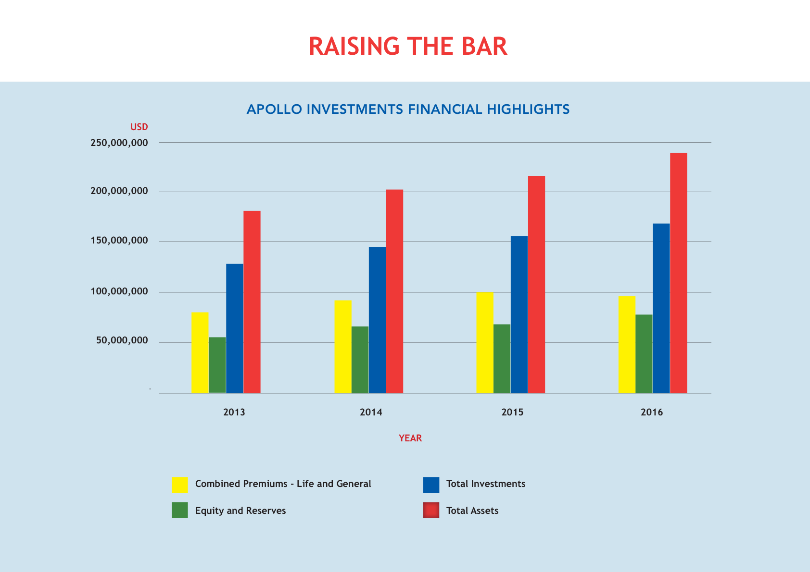
Apollo Group Financial Highlights

Slide 5
Apollo Group Awards

Slide 6
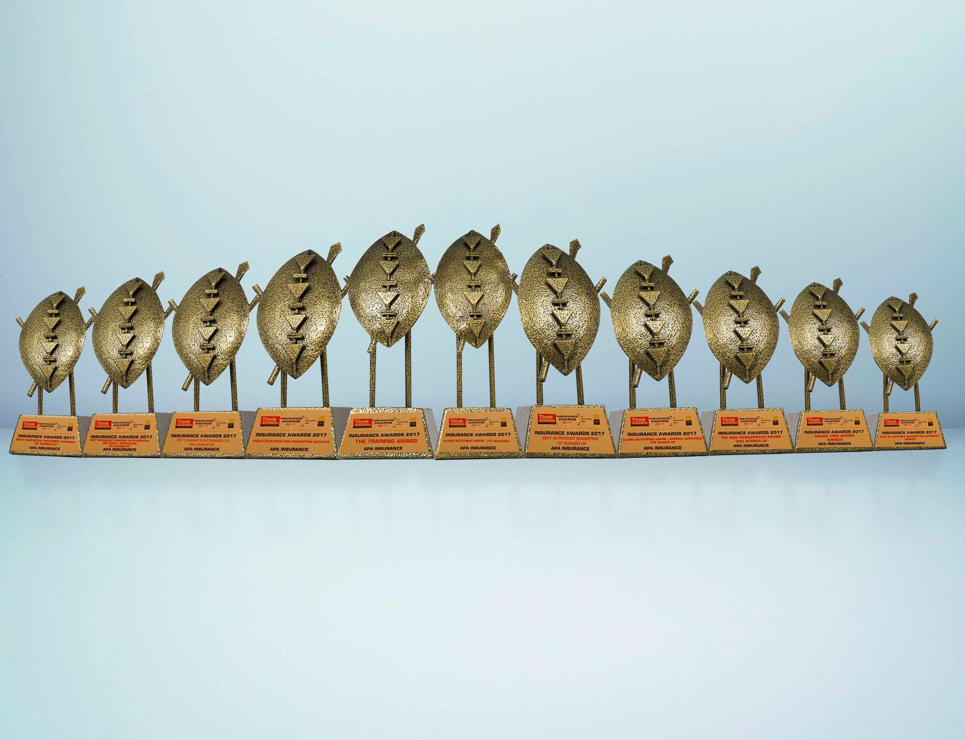
We always put our customers ﬁrst, that’s why the judges picked us ﬁrst.
APA is the Most Awarded Insurer at the 2017 Annual Insurance Awards.
Winner
• Best in Claim Settlement (Life)
• Fraud Detection & Protection
• Major Loss Award
•Training Award
• Best in Customer Satisfaction Index
1st Runners Up
• Best in Product Marketing
• Best in Product Innovation
• Best Insurance in Use
of Technological Application
2nd Runners Up
• Best in Claim Settlement (General)
• Risk Management Award
• Socially Responsible Corporate

Slide 7
Insurance as a solution in disaster risk finance and humanitarian assistance
Drought Appeal Insurance
Index Based Livestock Insurance (IBLI)
Area Yield Index Insurance (AYII)

Slide 8
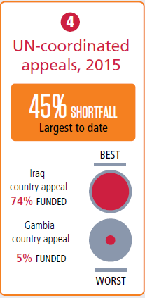
Drought Appeal Insurance: Rationale for proposing alternative financing
Common vision and mission, to reduce risk and to help people through crisis.
There is a need for new types of financing, efficiencies and good practices.
International humanitarian assistance increased in 2015 for the third consecutive year, reaching a record high of US$28.0 billion.
Some of the notable drought years based on IFRC reports are 1971, 1980, 1984, 2004, 2005, 2006, 2008, 2009, 2011, 2014 & 2016.
Source: Global Humanitarian Assistance Report 2016

Slide 9
Application of insurance to the response process
Daily rainfall measurement using satellite data (ARC2)
Final claims computation at the end of the contract (year)
Source: Acre Africa/APA

Slide 10
Application of insurance to the response process
To start with a catastrophic drought cover for Kenya has been developed based on rainfall data index.
IFRC wishes to have insurance product financing as part of the appeals budget. IFRC Secretariat to be the policyholder on behalf of members and shall receive the pay-out
Insurance will not cater for total cost of disaster assistance. Domestic governments have the primary responsibility to prepare for and respond to crises in their own territories
Insurer/Reinsurer will seek donor support through IFRC and other international bodies
An annual contract with a bimodal rainfall pattern will be structured into monthly triggers

Slide 11
Case Example based on IFRC Data
Proposed Geographical Coverage: Kenya
Proposed Perils to be covered: Drought
Tentative budget: 500,000 Swiss Francs for Kenya
Proposed coverage: Lower limit of 2m and upper limit of 5m
Data : Based on readily available 32 year daily historical satellite data .

Slide 12
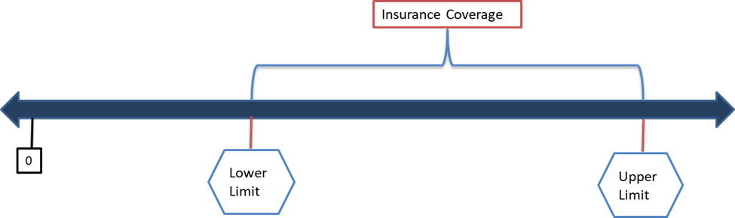
Case Example based on IFRC Data
The proposed cover is a weather index cover computed using historical rainfall data and payout triggered by set triggers which are county based.
Losses must be above agreed threshold to trigger compensation
Catastrophic drought is defined as 3 consecutive dry months below the set County triggers.
Source: Acre Africa/APA

Slide 13
Insights on insurance modeling
No of counties that received payout
Year
Source: Global Humanitarian Assistance Report 2016

Slide 14
Insights on insurance modeling
The data shows an increase in disasters over time both in frequency and magnitude. Most of these have been by lack of rainfall,
The maximum payout was in 2009 and as many as 20 counties were affected.
We propose one country for the pilot and an upscale is inevitable given its success. Roadmaps for additional countries to follow.

Slide 15
The Index Based Livestock Insurance Product – Partnership RC & APA
The Index Based Livestock Insurance (IBLI) product seeks to protect pastoralists from drought related lack of pasture for their livestock.
We use NDVI (Normalized Difference Vegetation Index) satellite images to estimate the amount of pasture in the insured unit at a particular time.
The database provides us with 15 years of historical data. The product and pricing use this data.

Slide 16
IBLI Covers:
IBLI covers Lack of forage for livestock which include sheep,cattle,camel and goats. It is an annual product which provides cover for 2 seasons (as per the rainfall patterns in the country).
It has 2 potential insurance payout periods:
Short Rain Short Dry season (SRSD) - (which runs from October to February of the following year – 5 months) with the forage being monitored as from October to December.
Long Rain – Long Dry season (LRLD) (which runs from March to September – 7 months) with the forage being monitored as from March to June.
Pay out to pastoralists are made once the forage is below the 20th percentile of the historical forage.
The cash received should be used by the pastoralists to buy feedstock for their livestock.

Slide 17
IBLI Sales/Payout Periods
Sale periods:
The cover can only be sold before the onset of the rains and this is due to the systems dependency of rainfall i.e.
January and February is the sales window for the LRLD window
September and October is the sales window of the SRSD window.
Premium Rates:
Given that each UAI is a different risk, the premium rates for the cover varies from unit to unit.
Potential Claims Payout Periods:
August for the Long rains window, and
February for the Short rains window.

Slide 18
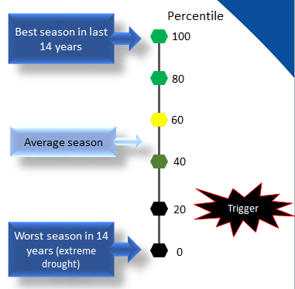
IBLI Sales/Payout Periods
What is the connection between the index and insurance payouts?
If the index shows that the forage availability at the end of the rainy period falls below the 20th percentile, history suggests that there will be drought and a payout should be made to enable pastoralists to protect their herd.
The 20th percentile is the ‘Trigger’ level for the IBLI Asset Protection Contract.

Slide 19
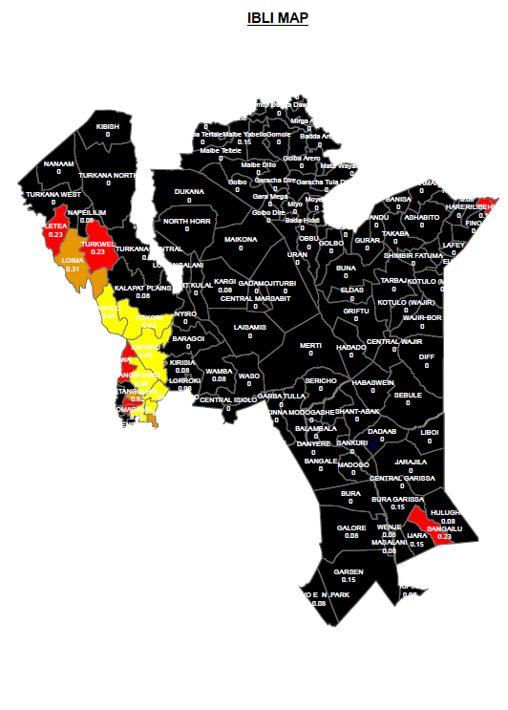
Announcing The Index
The seasonal NDVI is compared with values for the same season over the last 14 years and an Index Map is produced.
If the seasonal NDVI for an IBLI unit is as bad as historic seasons which fall below the 20th percentile, the Unit is coloured black.
Pastoralists in IBLI Units coloured black are eligible for a payout.

Slide 20
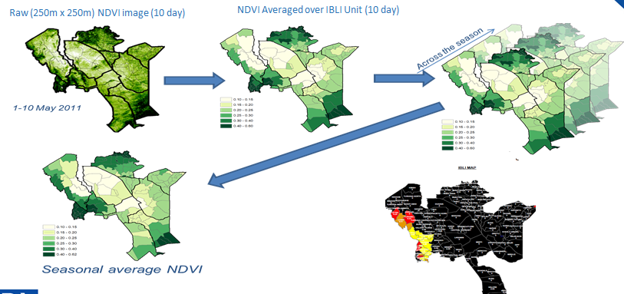
From NDVI To Payout
Source: International Livestock Research Institute

Slide 21
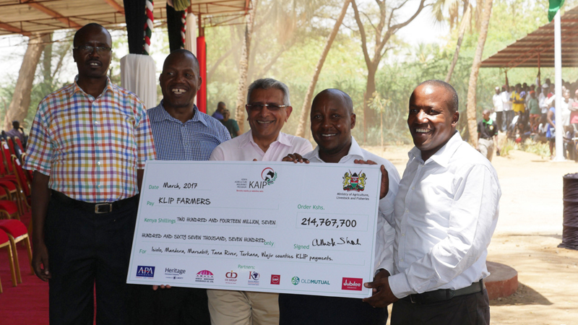
Payout for KLIP Farmers 2017
Payout Amounts 1USD = 103Kes
Isiolo | 14,628,600
Mandela | 27,042,400
Marsabit | 40,091,800
Tana River | 60,331,600
Turkana | 43,106,700
Wajir | 29,566,600
Total | 214767,700

Slide 22
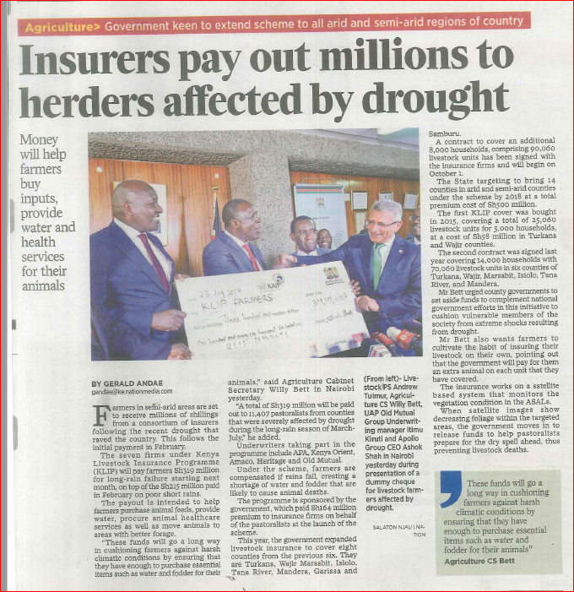
2nd Payout for KLIP Farmers 2017
Payout Amounts
Isiolo | 65,503,200
Mandela | 26,317,200
Marsabit | 45,934,000
Tana River | 78,937,600
Turkana | 59,915,800
Wajir | 42,583,800
Total | 319,191,000
Source: Daily Nation

Slide 23
Opportunity
Partnership between Swiss Re, APA and the KRCS represents a win-win opportunity:
KRCS will enhance its disaster response by improving its disaster risk management mechanisms as well as its efficiency and effectiveness.
Swiss Re brings in its expertise, modelling, technical and financial ability
APA and its service providers can ultimately enjoy new business opportunities and deepen insurance penetration thereby increasing its portfolio
KRCS has an opportunity to enhance its incentive structures for its volunteers while expanding its basket of disaster response strategies

Slide 24
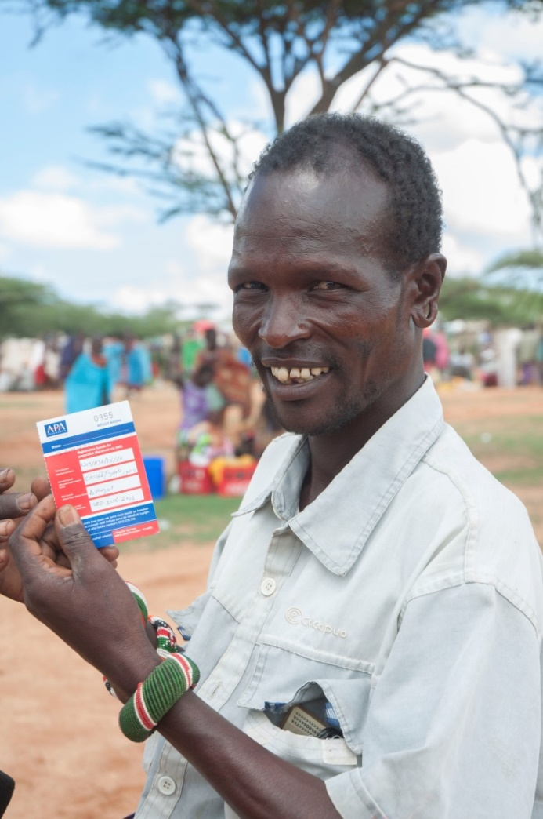
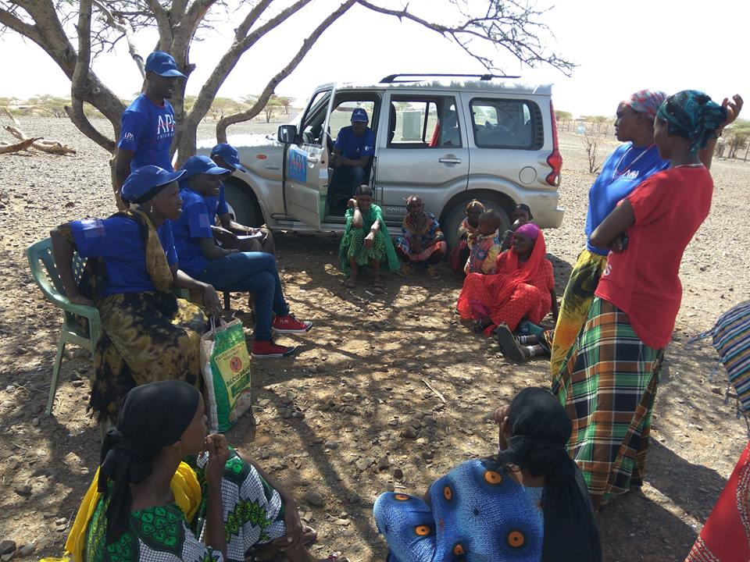
Pictorial
An APA beneficiary showing his insurance receipt after purchase of the IBLI product
Our staff members engaging with a women group in the field, Marsabit, Kenya

Slide 25
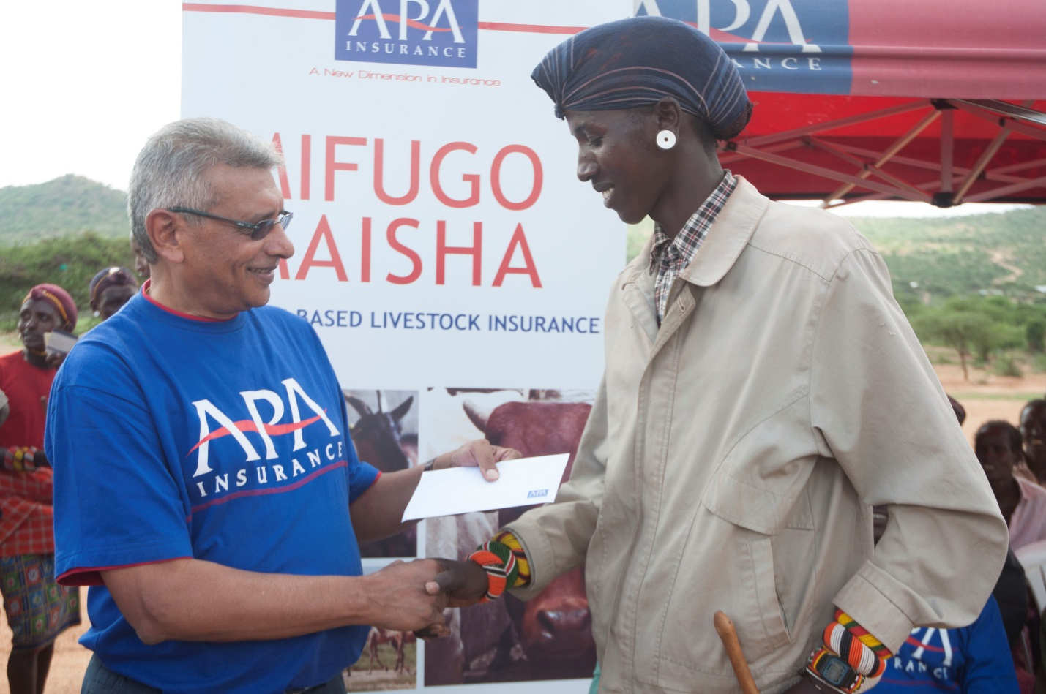
APA GCEO presenting claims payment to a pastoralist in Oldonyiro Division in Isiolo County

Slide 26
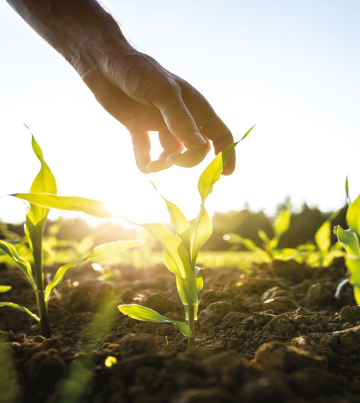
Area Yield Index Insurance (AYII)
AYII is an insurance that covers farmers against yield shortfall caused by adverse conditions like damage by insects, plagues etc.
Farming areas are divided up into insurance units (UAI) – if actual production in the UAI falls below its threshold, all farmers who have enrolled for the cover in the UAI receive a payout.
AYII is a viable alternative to:
Enable the farmers to get compensation and continue normal life after a loss
Reduce the impact of disaster- e.g. farmers able to get cash to buy new inputs, replace lost stocks, etc.
Increase farmers’ access to credit, and inputs
Improve agricultural productivity, transition from subsistence to commercial farming

Slide 27
Area Yield Index Insurance (AYII)
Majority smallholder farmers’(80%) are categorized as vulnerable:
Dependence on rain-fed agriculture
Difficulties in accessing credit, farm inputs
Low resilience: inadequate access to information and capacity to manage bad situations; subsistence farming
Results:
Most small scale farmers remain poor and trapped in poverty cycle;
Difficulties in moving from subsistence to commercial agric
Continued low agric productivity and food insecurity
People especially the youth run away from agric as a poor man’s job

Slide 28

T H A N K Y O U

